Slide 1



富明精密
Technology lights up you and me
Technology changes lives
Building K,No.2,LongShan 8 Road,Luotian Community,
Yanluo,Baoan District,Shenzhen,China

Slide 2
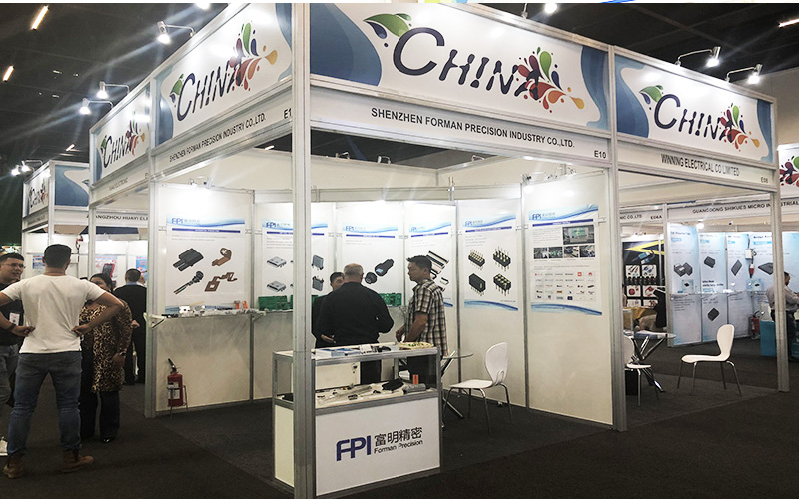
公司简介
COMPANY PROFILE
Shenzhen Forman Precision Industry Co., Ltd.(Abbreviation FPIC) has always been committed to the research, development, and manufacture of connectors over 21 years. With the development of the technology and changes of customer requirements, FPIC has expanded new business range which is for OEM energy storage cables, medical wire harness, industrial wire harness, automotive wire harness and other electrical wire harness since 2010. As so far, the plant covers over 20,000 square meters, our total investment capital is almost USD10 million, and the annual sales amount is higher than USD20 million.

Slide 3
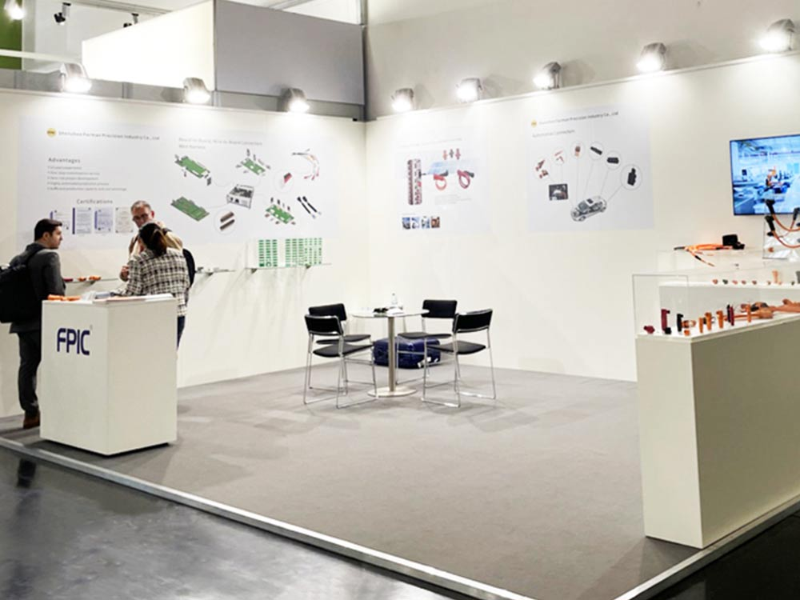
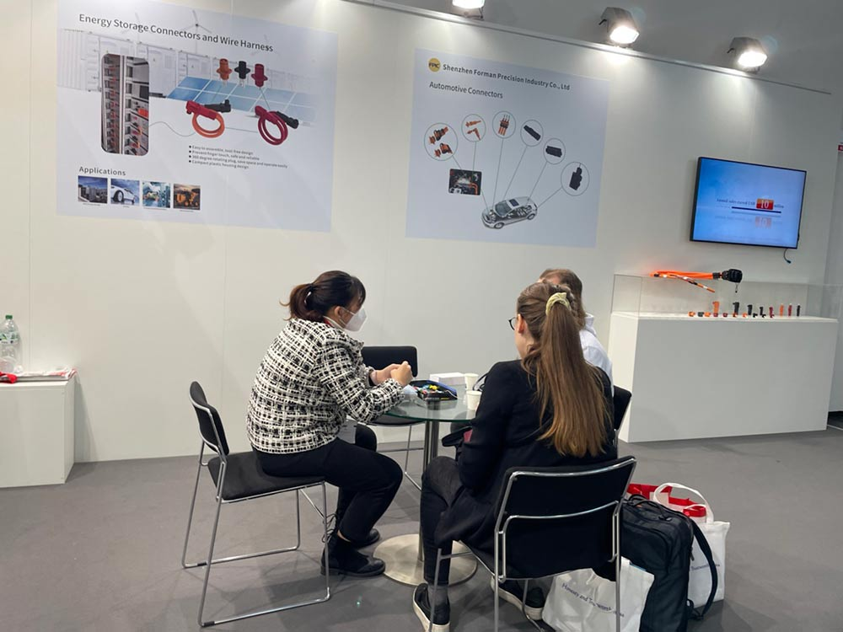
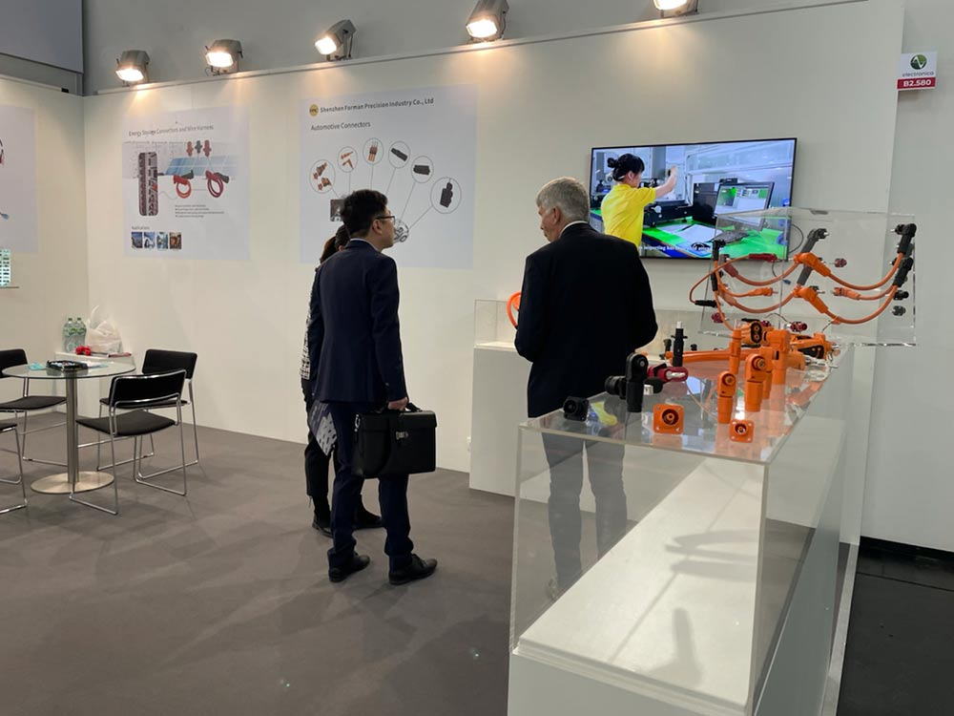
服务理念
SERVICE CONCEPT
Insisting on the philosophy of “Focus on Customer, Contributor Based, and Always Going All Out”, FPIC offers good quality controlling capability, super flexible delivery, and continuous cost optimization, we look forward to working together with you for mutual development and benefits 。

Slide 4
质量管理体系
QUALITY MANAGEMENT SYSTEM
FPIC has been attaching importance to scientific production and efficient quality control, we have introduced the ISO9001, ISO14001, ISO13485 and IATF16949 management systems, also the ERP and MES production control systems 。
Quality is the lifeblood of business survival
The company has a complete and scientific quality management system and advanced automatic processing equipment.
Customer first, quality first, encourage innovation
In the business process, the company adheres to the business philosophy of “full participation, quality products, customer satisfaction, continuous improvement”.
Quality assurance::
100% quality control
Check all incoming materials, including
components and cables
Products meet IPC/WHMA-A-620 D cable and harness
components requirements and acceptance
Ensure compliance with RoHS and REACH requirements.
Full participation, quality improvement, continuous improvement
High-quality management personnel and technicians, highly trained, experienced and skilled industrial workers ensure stable product quality and always lead the industry and processing level

Slide 5
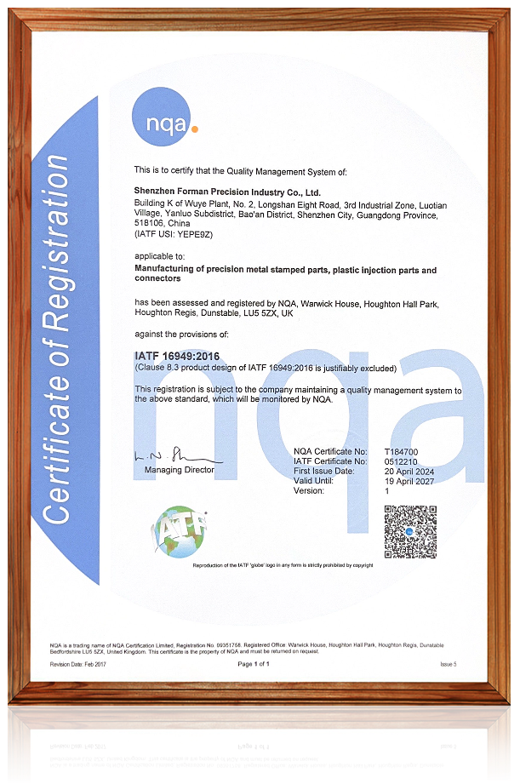
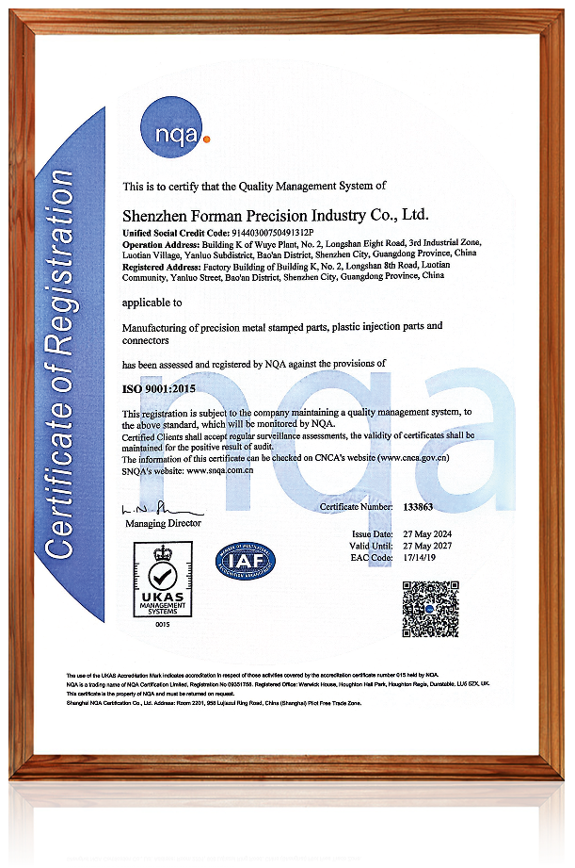
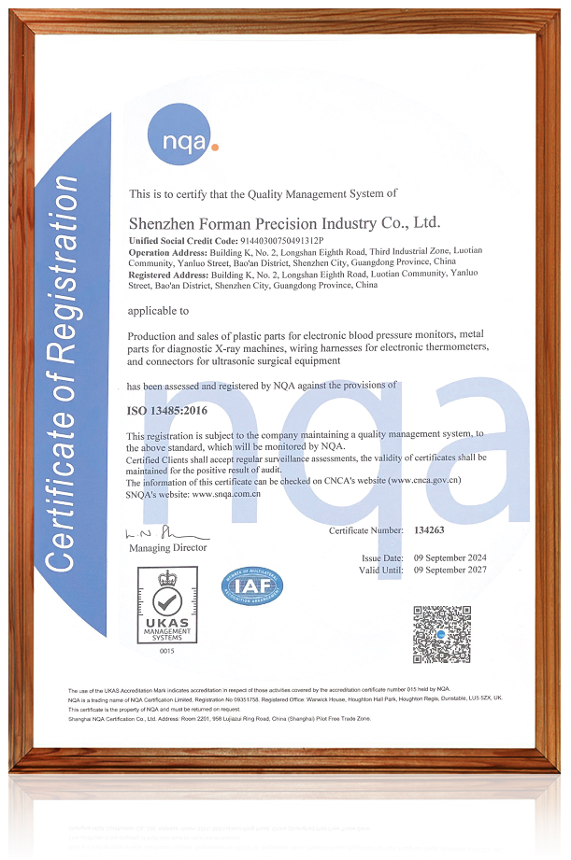
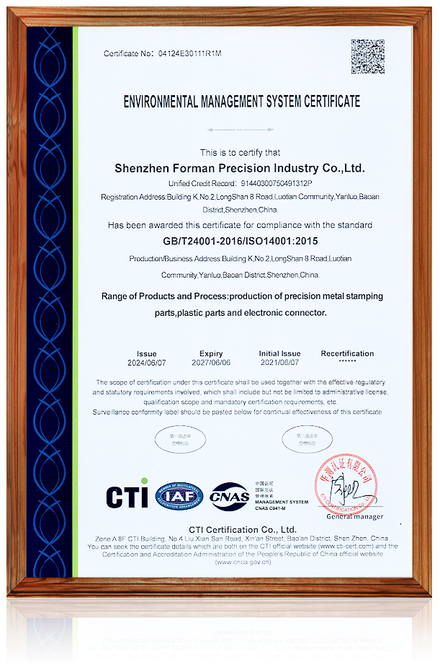
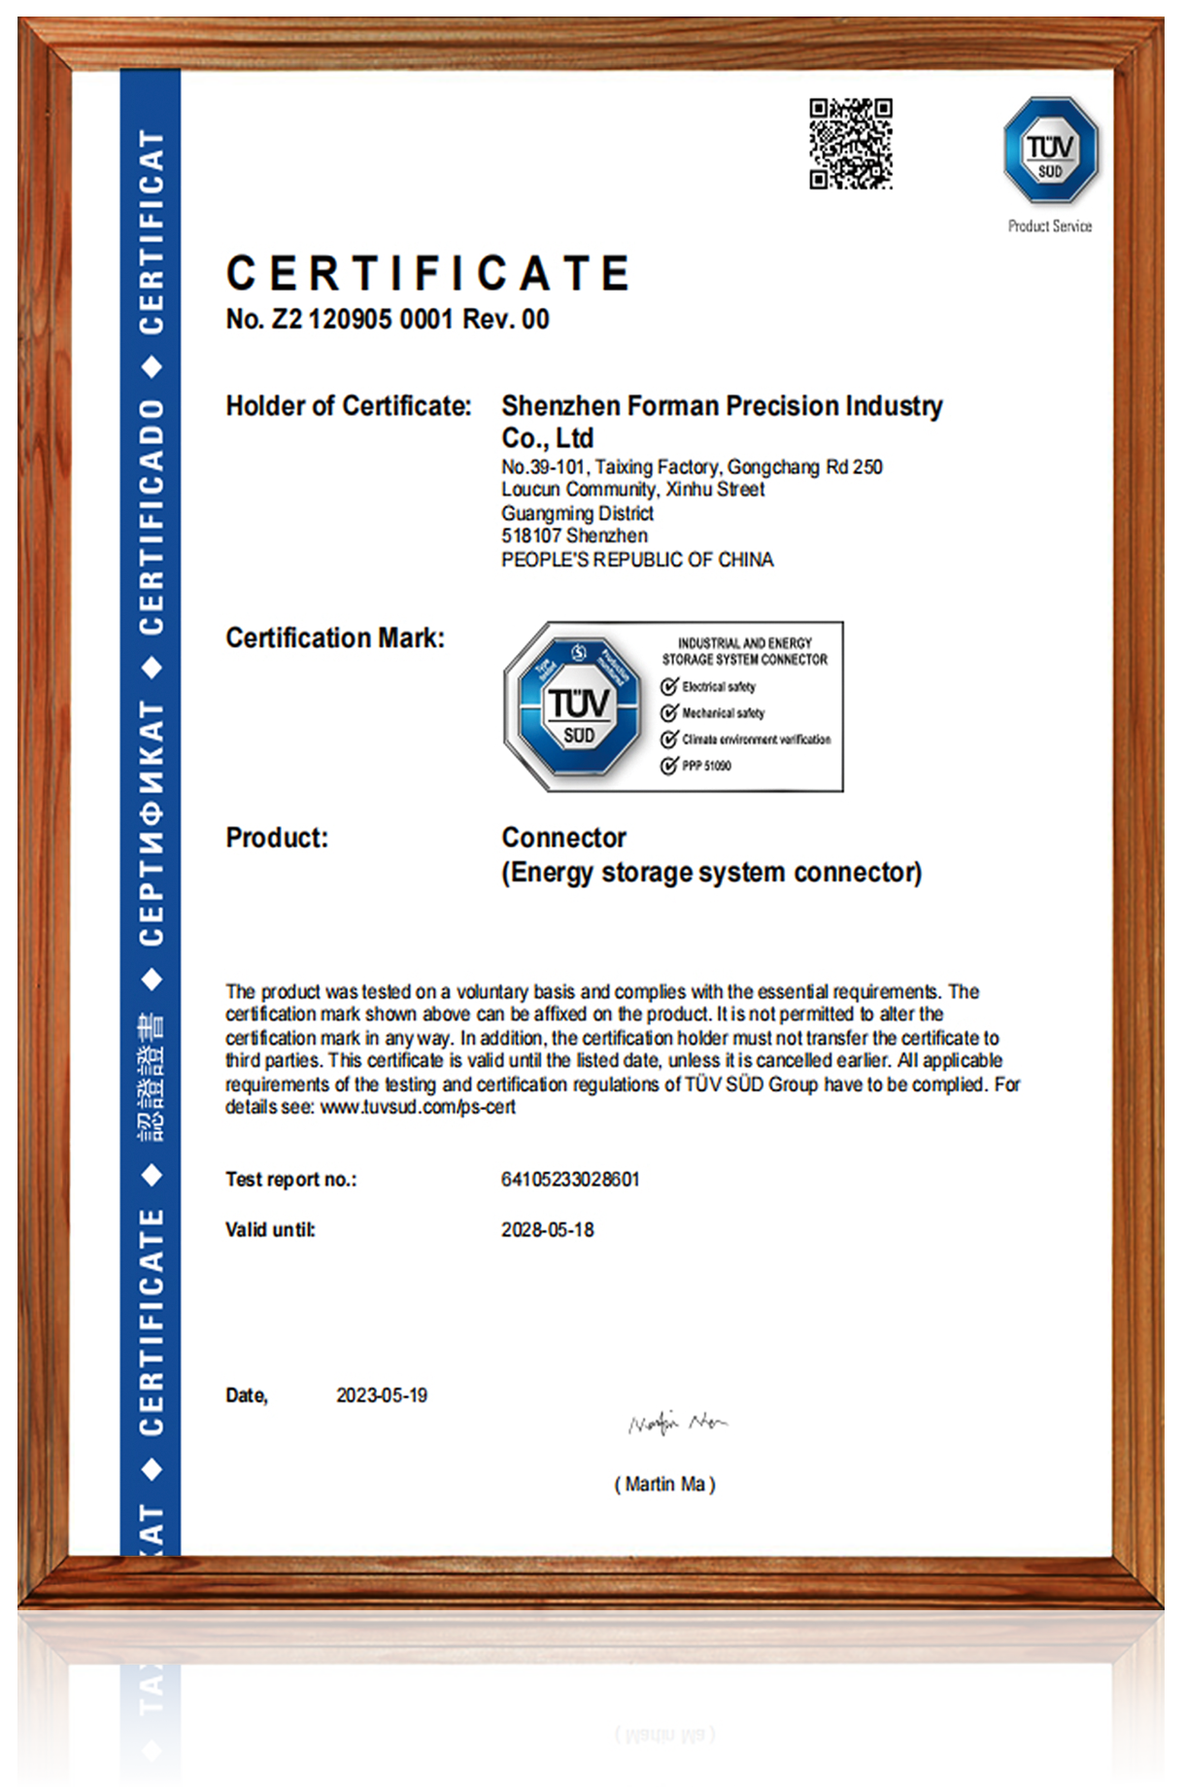
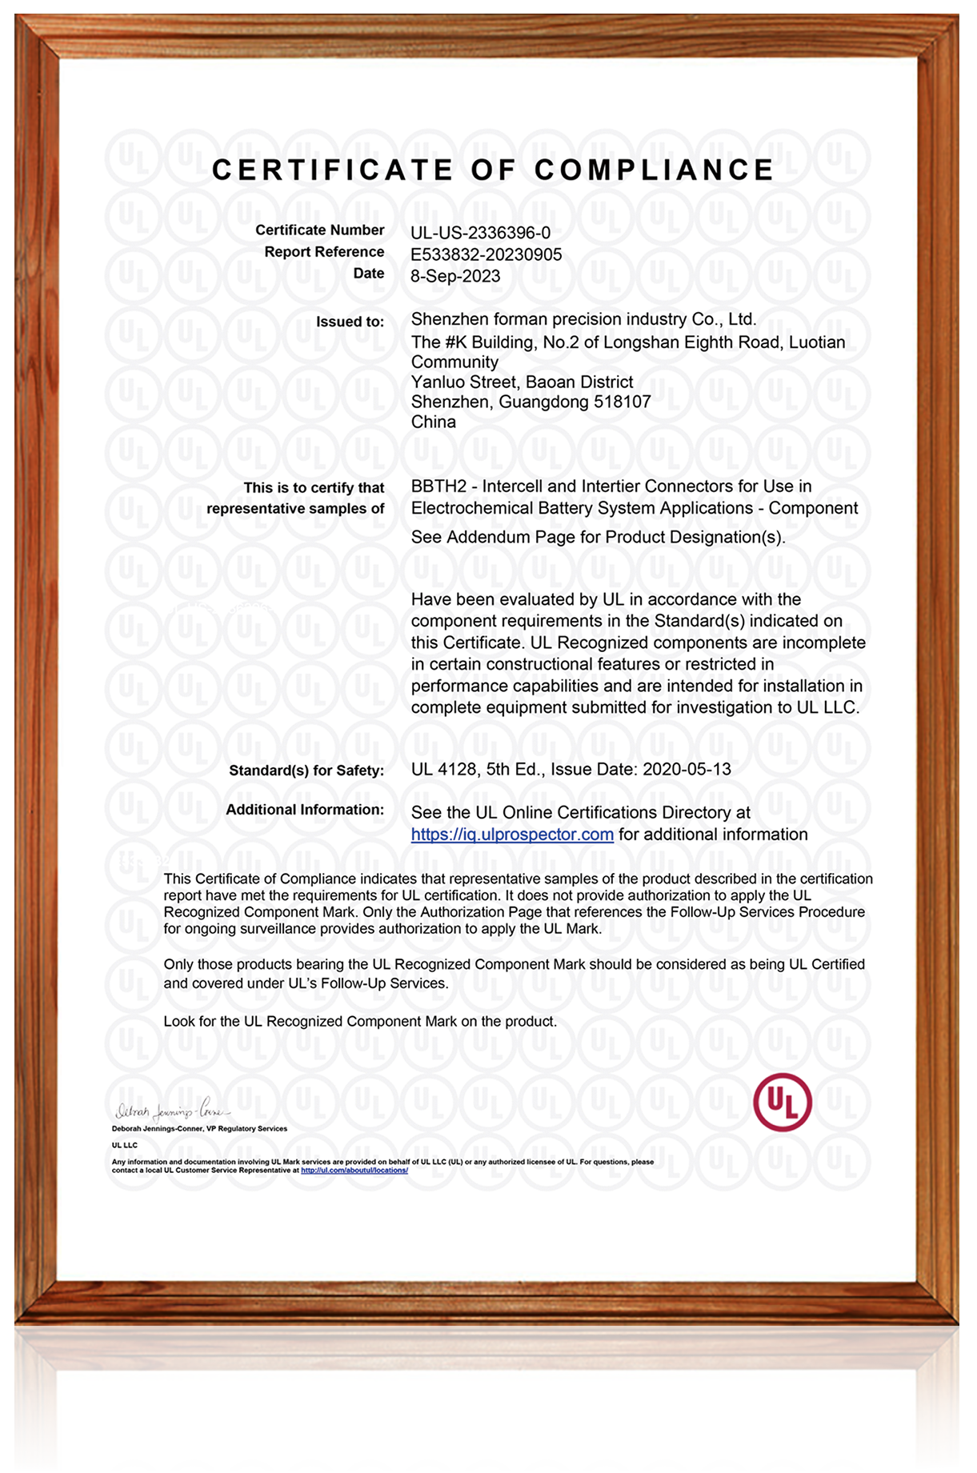
证书
CERTIFICATES
  ISO9001
  ISO14001
  ISO13485
  IATF16949
  TUV Verified
  UL
IATF16949
ISO9001
ISO13485
ISO14001
TUV Verified
UL Verified

Slide 6
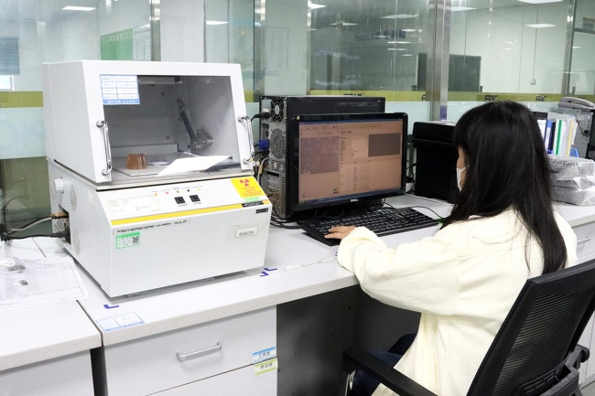
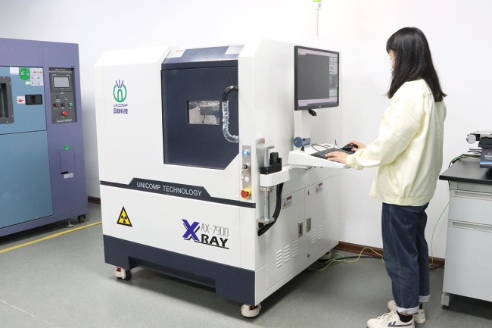
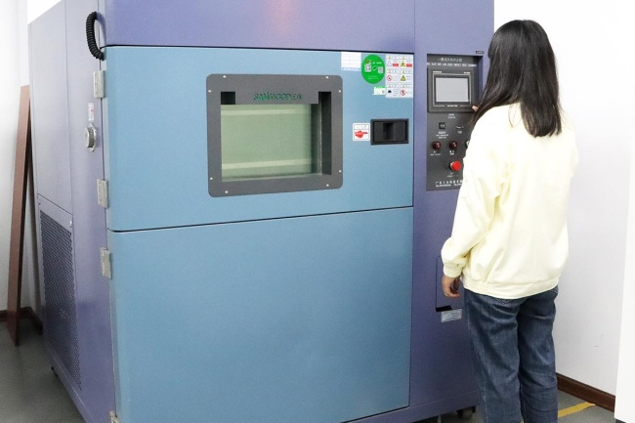
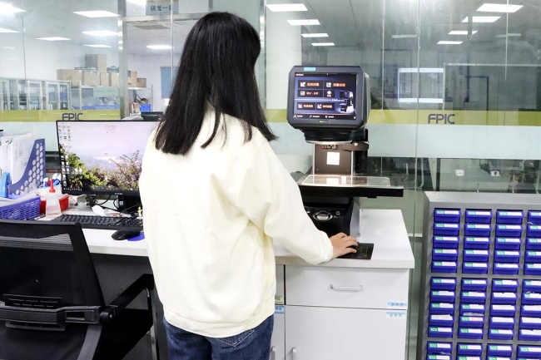
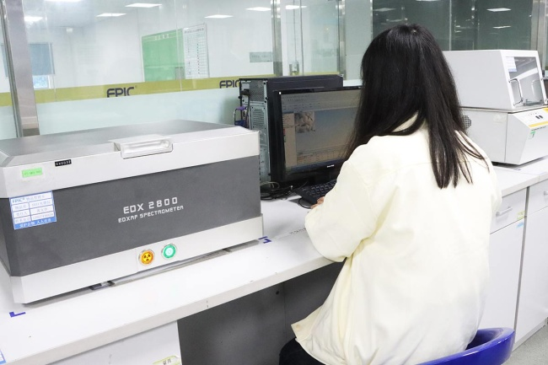
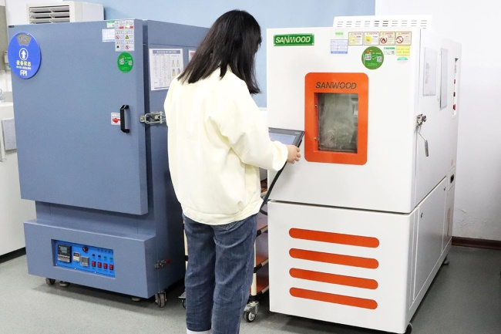
实验室设备
LABORATORY EQUIPMENT
X-Ray Plating thickness tester
X-Ray scenograph
Thermal shock test chamber
Keyence tester
Halogen testing machine
Constant temperature &amp;
humidity tester

Slide 7
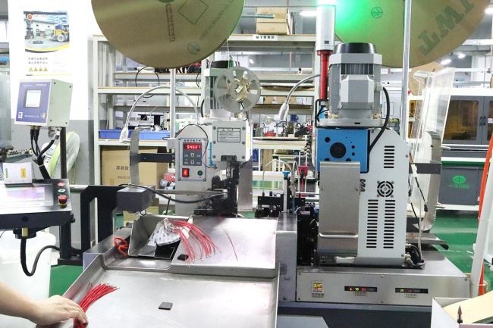
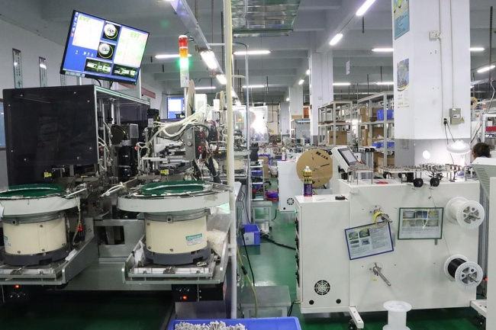
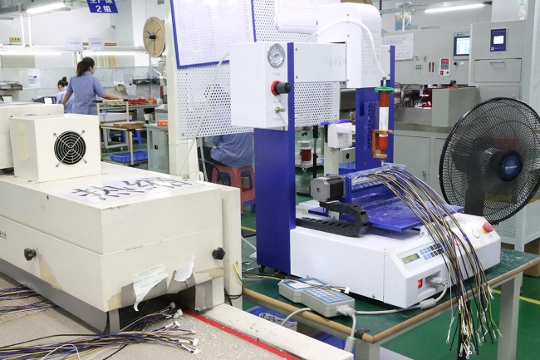
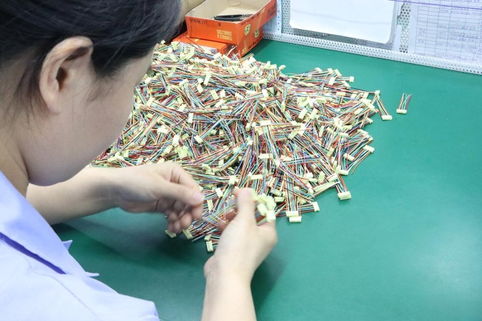
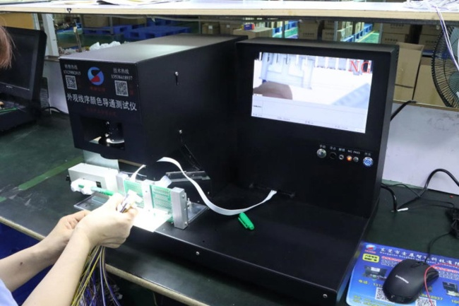
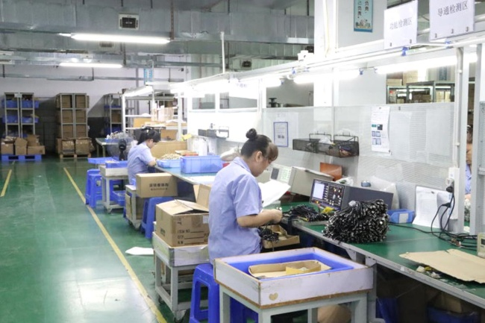
车间一角
THE WORKSHOP
Automatic wire cutting
terminal crimping machine
Full-automatic double-end
insert housing machine
Automatic glue dispenser
Appearance check
Check product alignment
Product electrical testing

Slide 8
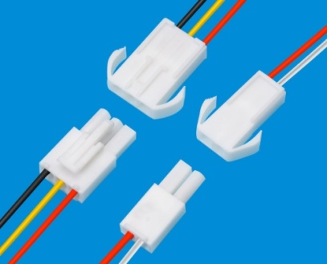
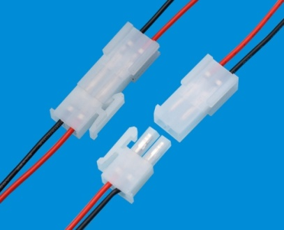
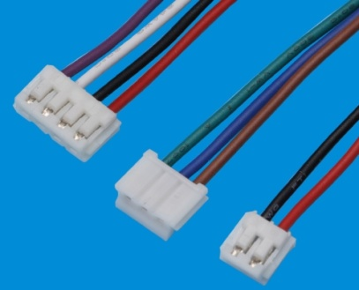
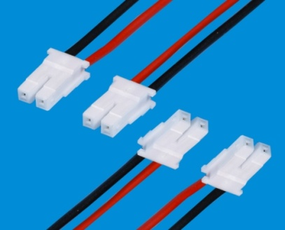
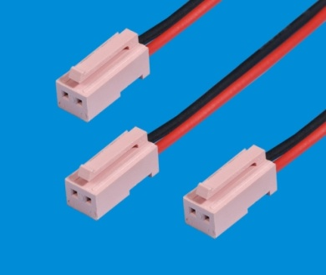
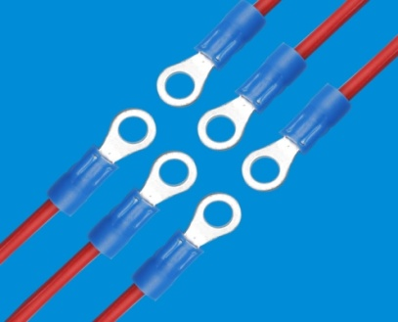
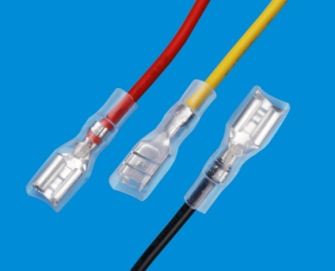
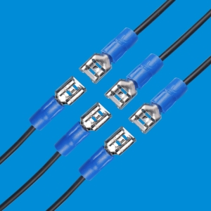
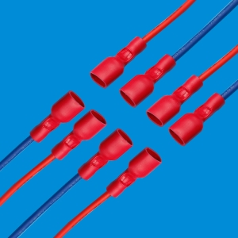
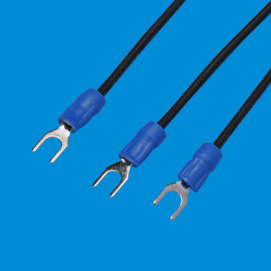
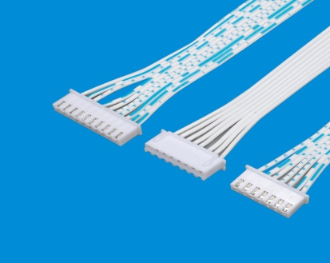
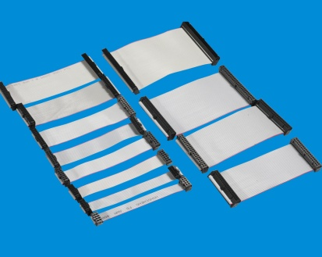
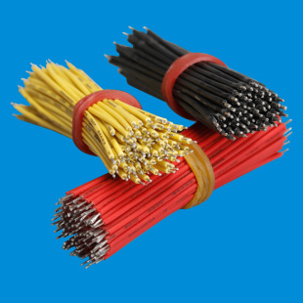
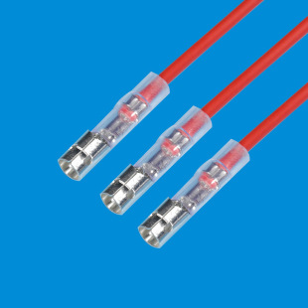
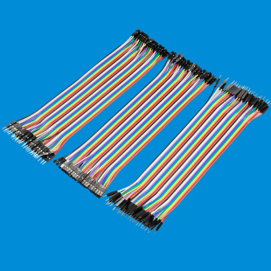
产品展示
PRODUCT DISPLAY
Terminal wire harness

Slide 9
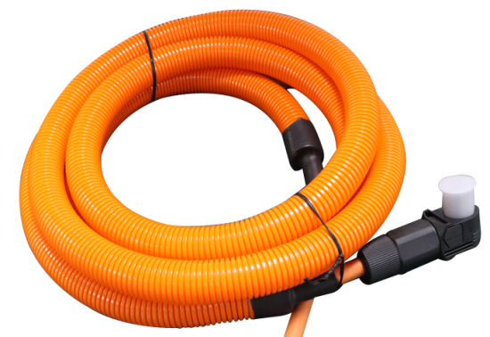
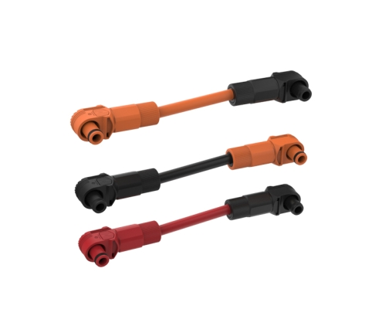
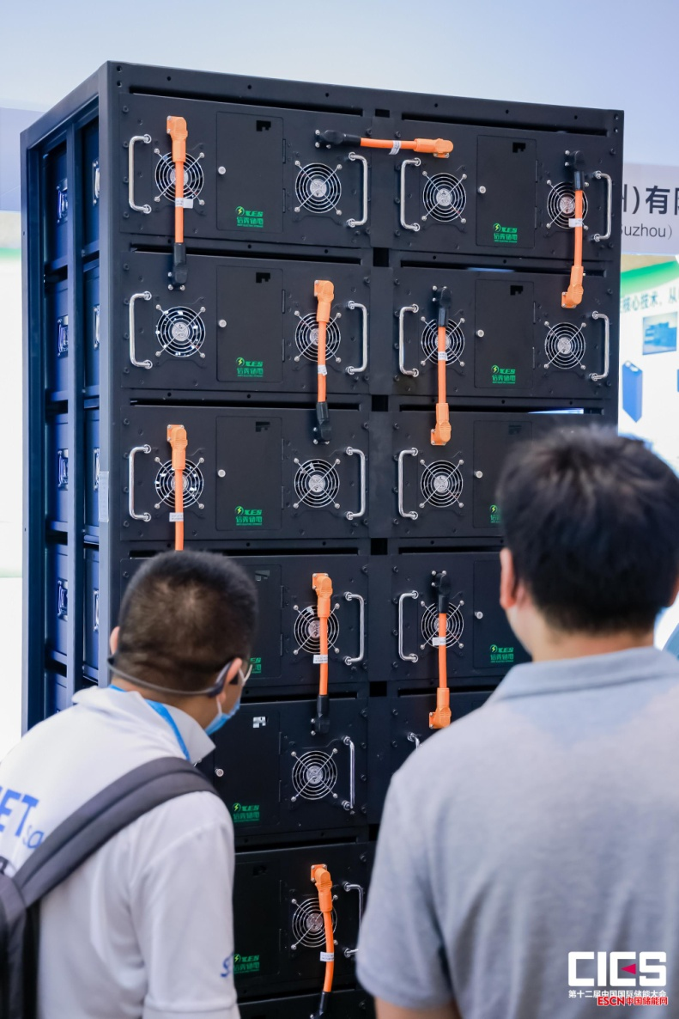
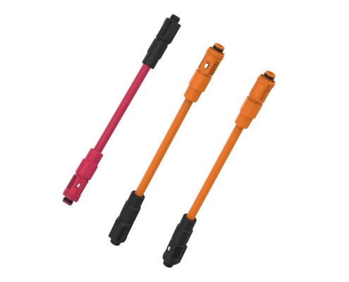
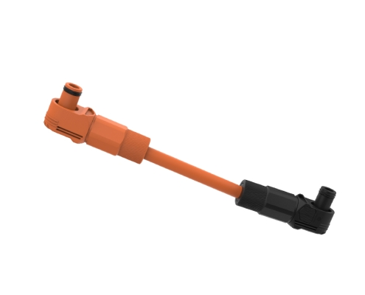
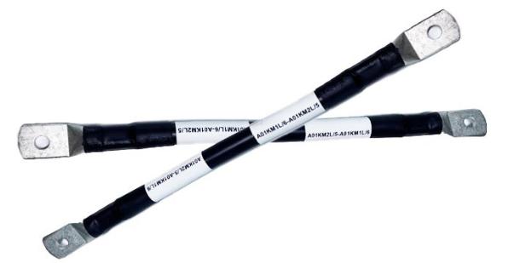
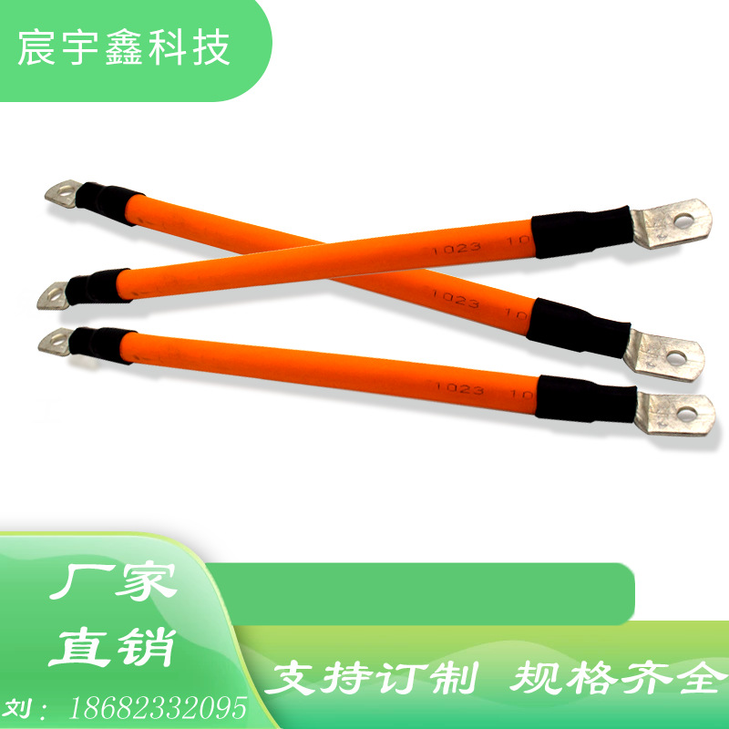
产品展示
PRODUCT DISPLAY
New energy wire harness--- Energy storage wire harness

Slide 10
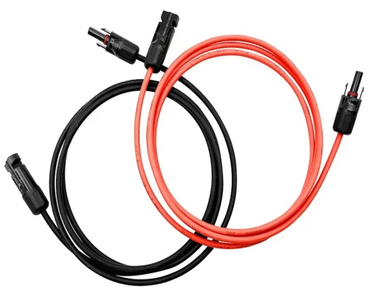
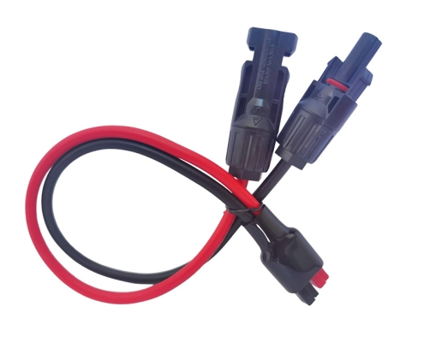
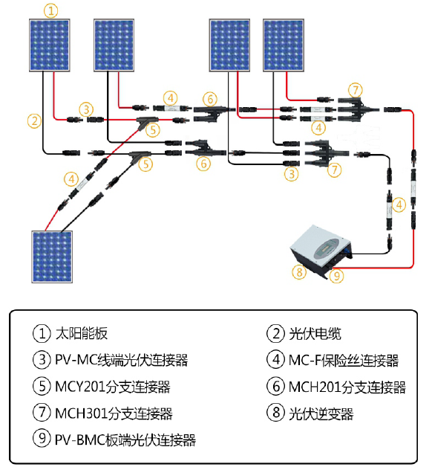
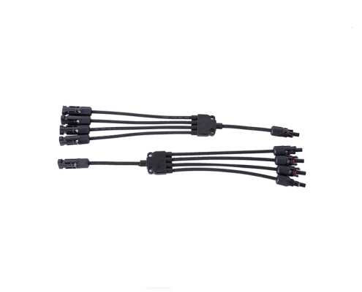
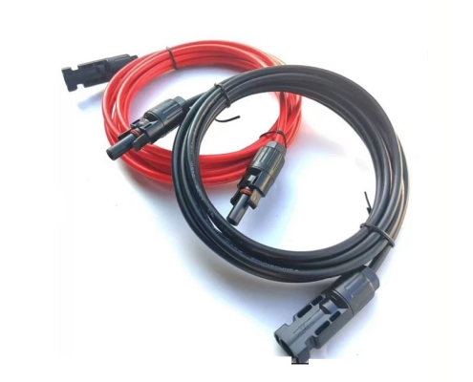
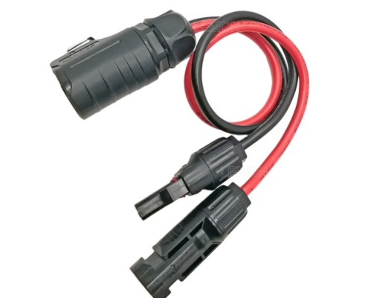

产品展示
PRODUCT DISPLAY
New energy wire harness--- Solar wire harness

Slide 11










产品展示
PRODUCT DISPLAY
New energy wire harness--- E-bike wire harness

Slide 12







产品展示
PRODUCT DISPLAY
New energy wire harness--- Electric vehicle wire harness

Slide 13









产品展示
PRODUCT DISPLAY
Automotive wire harness

Slide 14








产品展示
PRODUCT DISPLAY
Medical instruments wire harness

Slide 15


















产品展示
PRODUCT DISPLAY
Machine equipment wire harness

Slide 16
产品应用
APPLICATIONS
Our products are widely used in various industries, mainly electronic, communication, lighting , New energy, medical equipment, industry, etc., high-quality products, excellent quality, punctual delivery and satisfactory service for the company to win credibility and today's development.
Electronic Product
Communication
Illumination
New Energy
Medical equipment
Computer and
peripheral
equipment
Car
Industry

Slide 17




