Slide 1

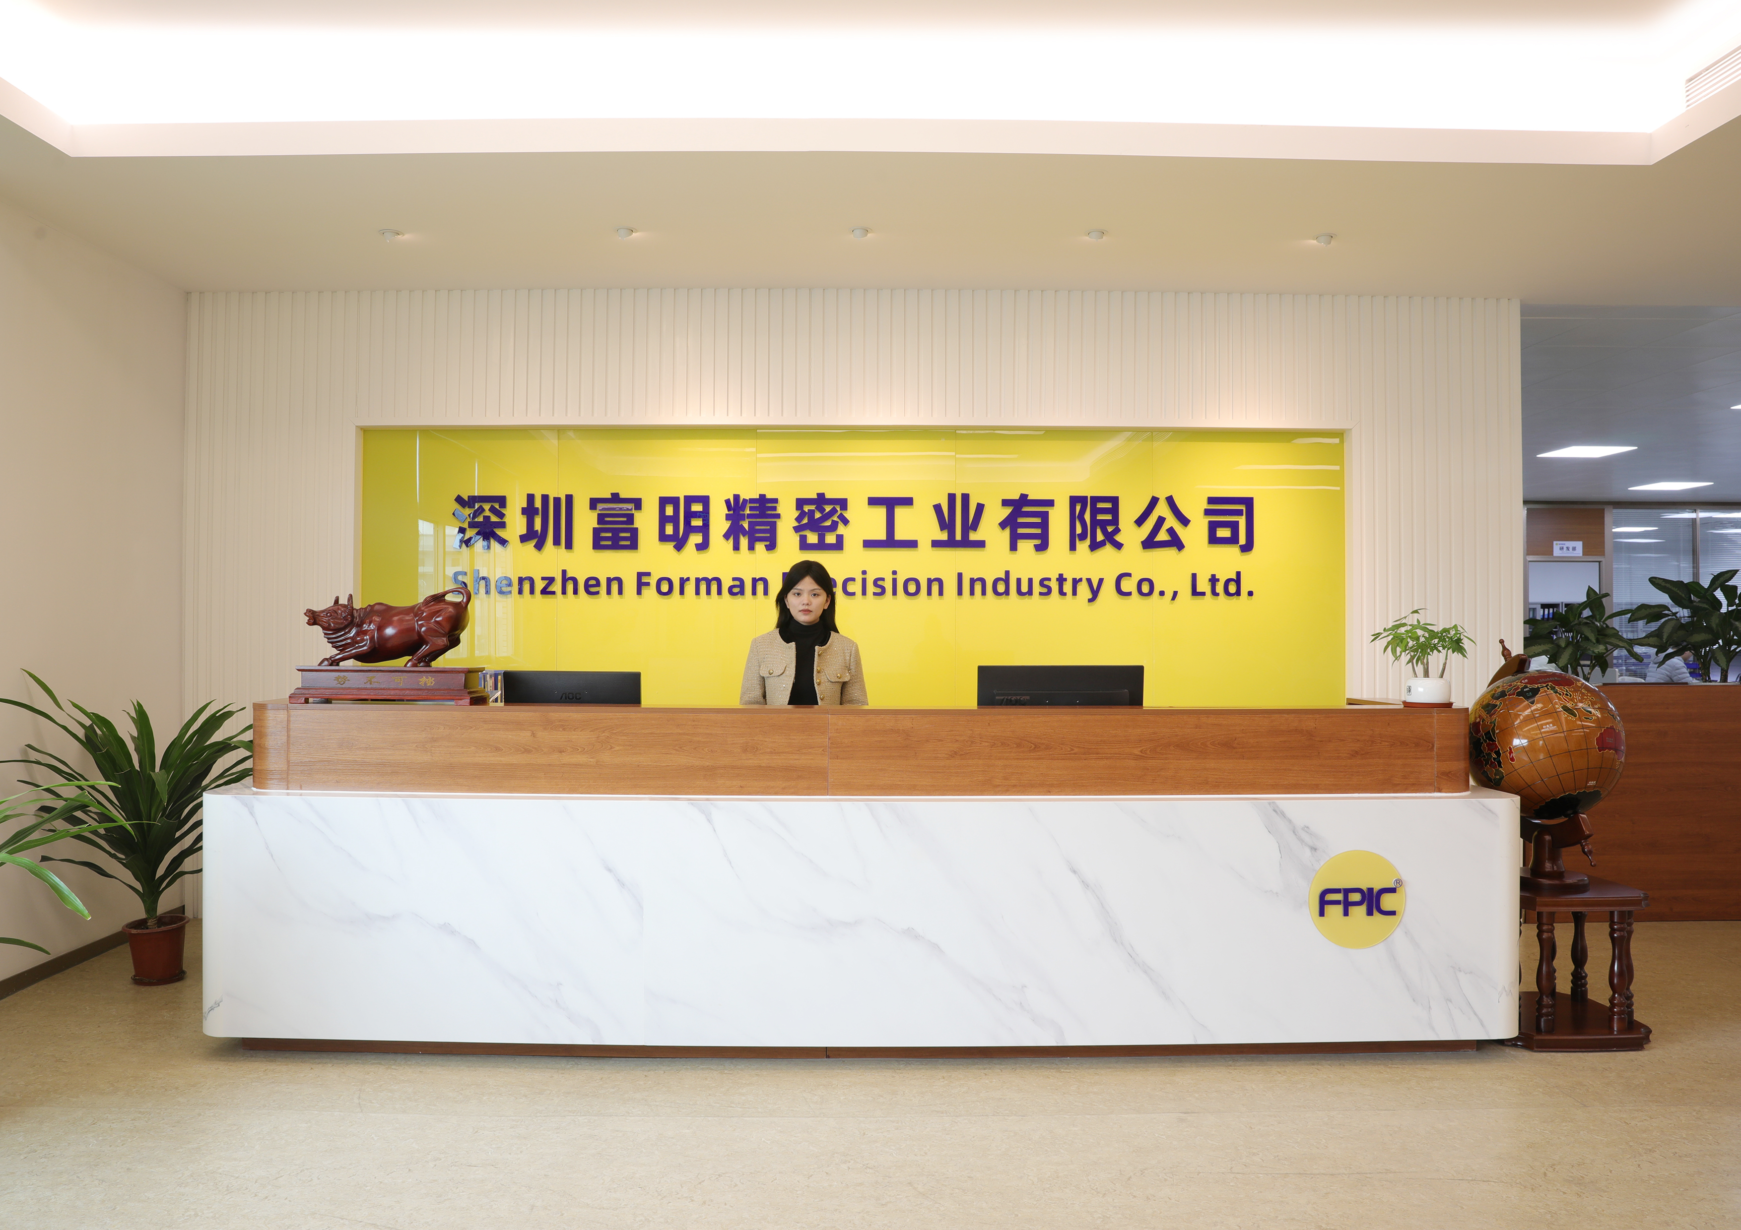
深圳富明精密工业有限公司
Shenzhen Forman Precision Industry Co.,Ltd.
Our Core Value:
Customer-centric,
Contributor-Oriented,
Always try our best!

Slide 2
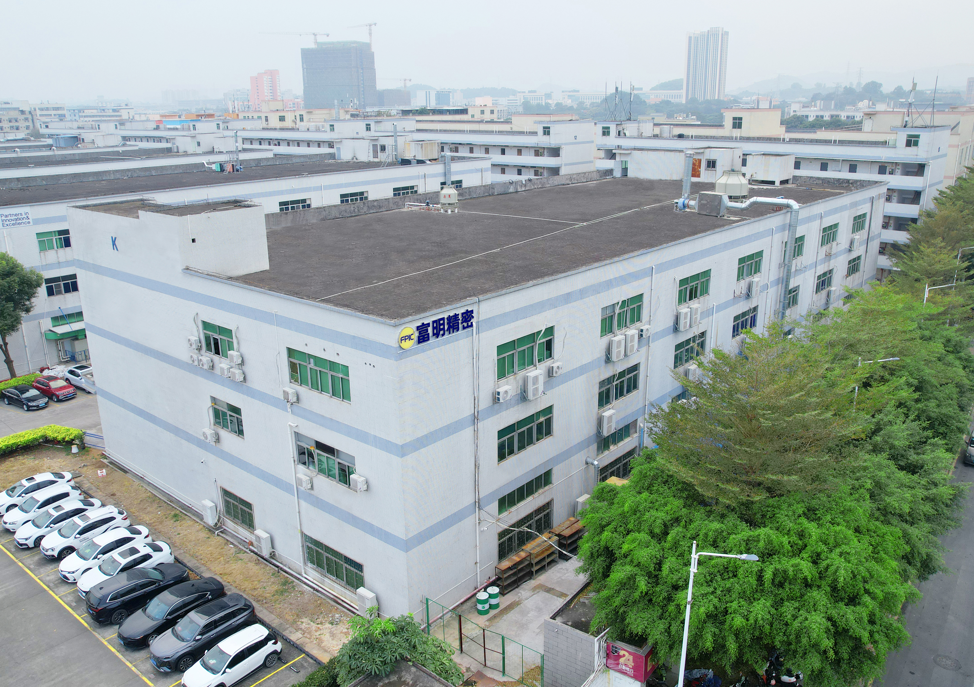
About us
Shenzhen Forman Precision Industry Co., LTD is a leading and experienced manufacturing vendor, dedicated to the development of metal and plastic parts. For over 20 years, we have specialized in the design and production of connectors and cables. Our market spans the automotive, new energy, industrial automation, and medical devices sectors.
We are certified by ISO 9001, ISO 14001, IATF 16949, and ISO 13485, and we are also a member of the USB Association, with UL and TUV certifications.
Our goal is to provide a unique service experience and add value for our customers through end-to-end management. We take pride in our reputation for being fast, flexible, and customer-focused.

Slide 3
Our core values
Customer-centric
Understanding and meeting customer need is our company’s duty. We continuously improve our product research and development, manu-facturing processes, and management capabilities to better serve our customers and maintain an unbeatable position in the competition.
Contributor-oriented
Strive to optimize our company’s various management and incentive systems, so that contributors who can better serve customers and continuously improve the company’s capabilities can receive better respect and welfare benefits.
Always try our best
We always try our best to serve every customer anytime.

Slide 4
Company Developments
2003
2004
2006
2013
2016
2023
2024
Today
Foundation
ISO9001
Auto assembly with CCD
ISO14001
IATF16949
UL/TUV
ISO13485
180 employees, 11000 ㎡

Slide 5
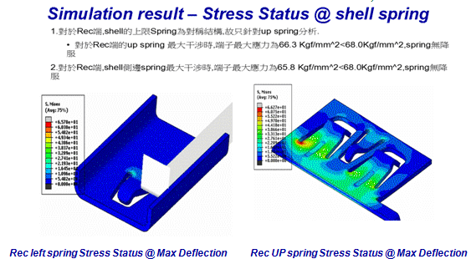
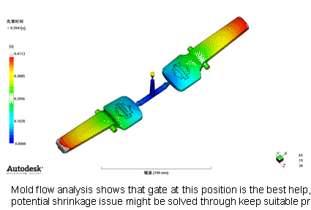
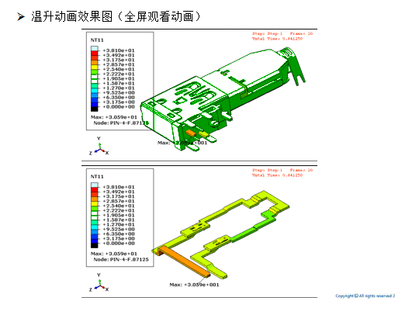
Product Design and Tooling Development
Have 15 production/tooling engineers who have more than 10 years professional experience.
Develop software - PROE, AutoCAD
Process Validation Tool -APQP, PPAP, FMEA, SPC, MSA
Develop Simulating software : Part Design, Tooling Design, Rating Testing
Part Design simulation
Tooling design simulation
Rating test simulation
Mold flow simulation test
Current rating simulation test

Slide 6
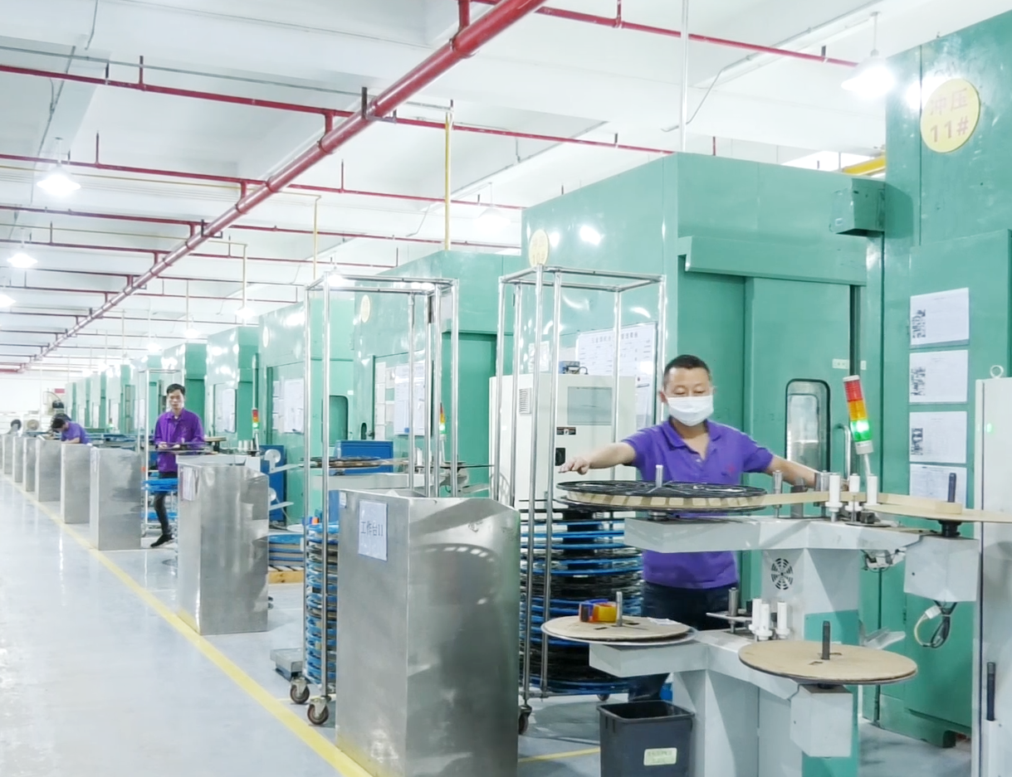
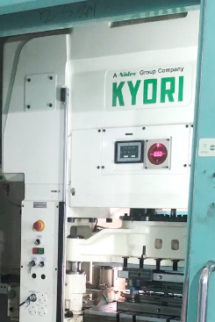
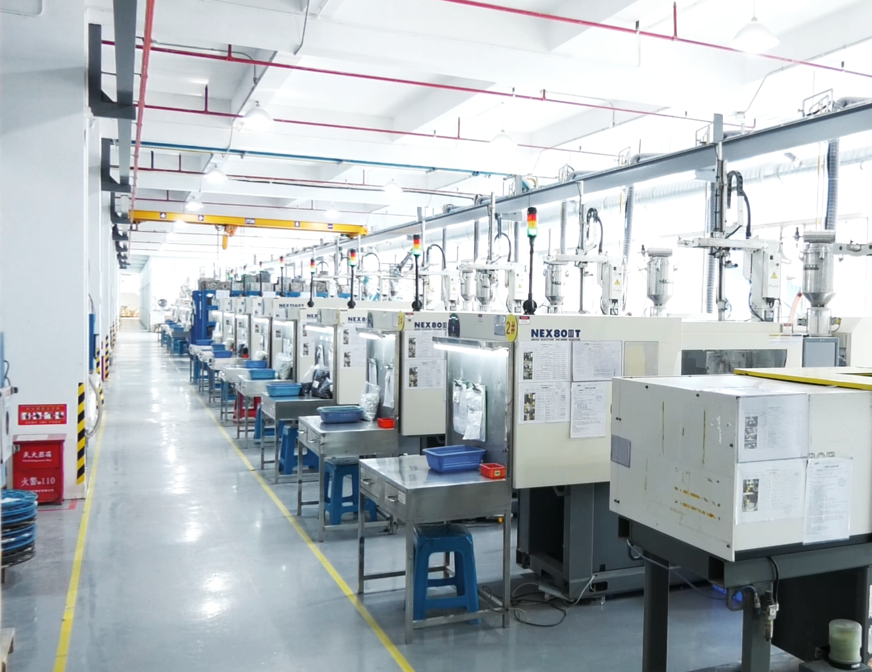
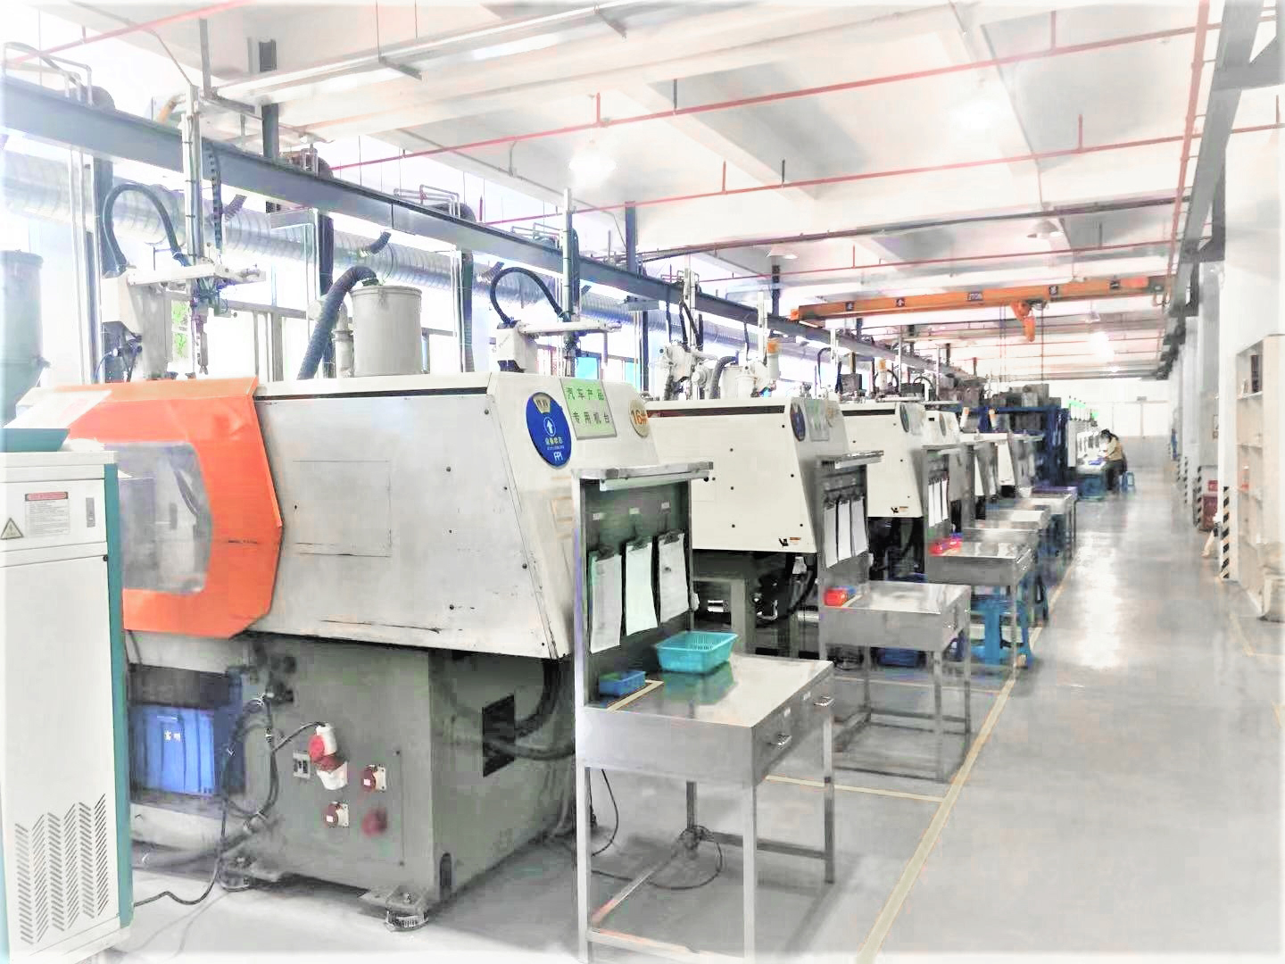
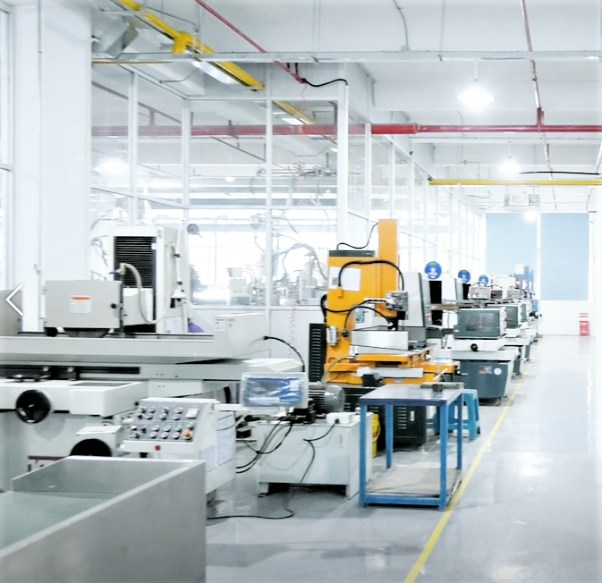
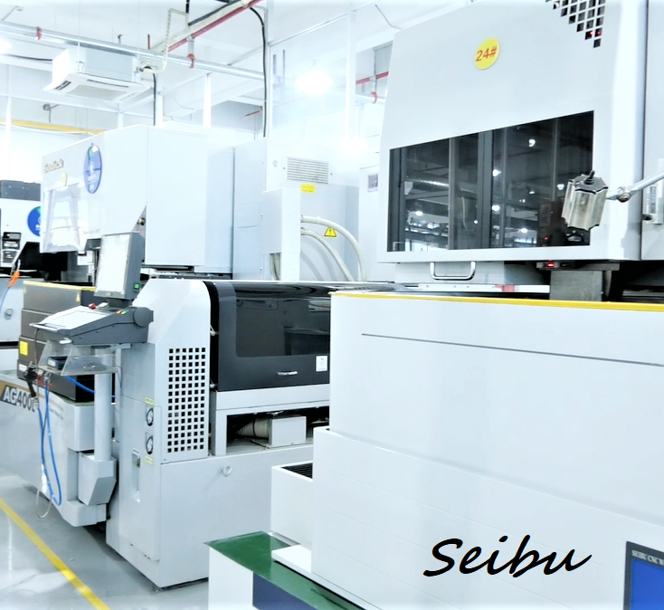
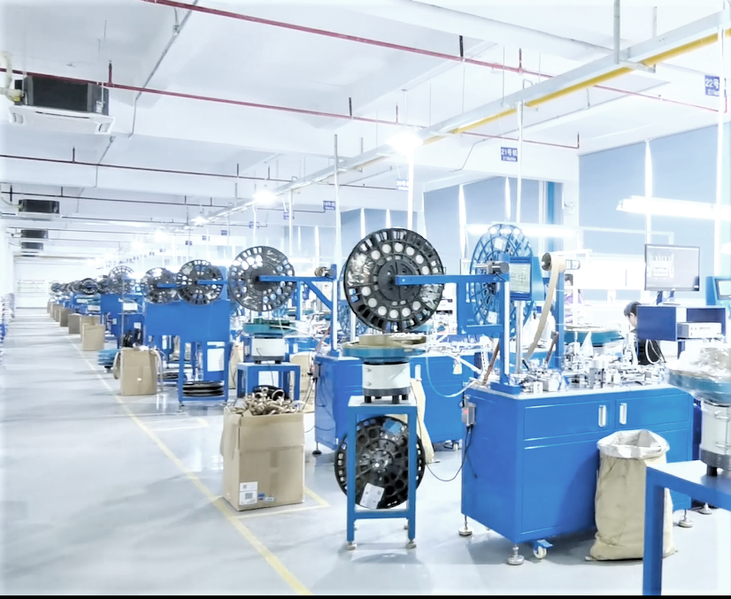
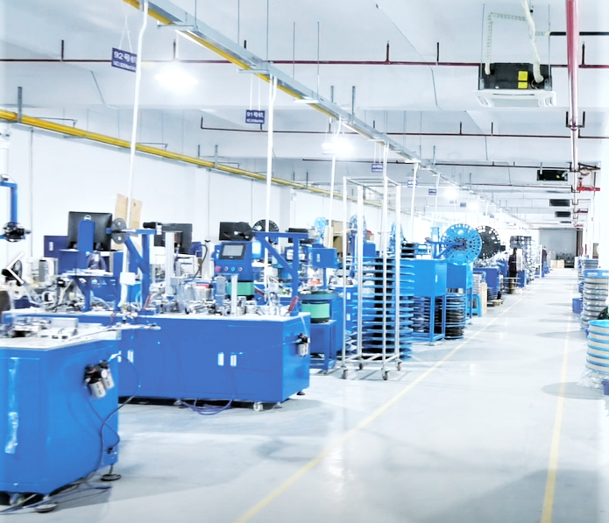
Workshops & Equipments
Stamping Workshop
Plastic Injection Workshop
Tooling Machining Workshop
Auto Assembly Workshop（with CCD)

Slide 7
Workshops & Equipments
Machine List
Exsiting machines of tooling workshop
Name | Model | Brand | QTY | Name | Model | Brand | QTY
WEDM | M50B | SeiBu(Japan) | 1set | Grinder | 614S | HYFAIR(TW) | 11sets
WEDM | AQ560LS/400L | Sodick | 3 sets | Big Grinder | KG-S-306AH | HYFAIR(TW) | 2sets
EDM | M30F | ARD | 3sets | Grinder | JL614 | Zhun Li(TW) | 3sets
Wire Cut | H-CUT 40F | Lian Gao (SZ) | 3 sets | Grinder | JL614 | Yu Qing(TW) | 2sets
Milling machine | 16SS | KUNMING （TW） | 1set
Exsiting machines of stamping workshop
Name | Model | Brand | QTY
High-speed Stamping | 35T~60T | LIDING | 8 sets
High-speed Stamping | 35T~40T | MICRON | 13 sets
High-speed Stamping | 40T | Japan KYORI | 1 sets
High-speed Stamping | 110T | SEYI(TW) | 2sets
Exsiting machines of injection molding workshop
Name | Model | Brand | QTY | Name | Model | Brand | QTY
Horizontal injection molding machine | 50T-180T | Taichung(TW) | 12 sets | Vertical injection molding machine
 | 80T-110T | Nissei(Japan) | 8 sets |  | 55T | Kunshan Baisu | 9 sets
 | 30T、300T | Fanuc | 2 sets |  | 25T | Zanyang | 1 sets
 | 90T | Zhongtai | 2 sets

Slide 8
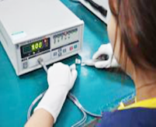
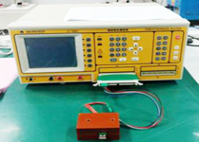
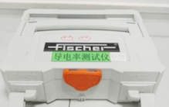
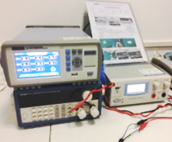
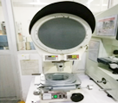
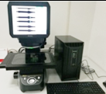
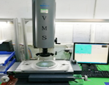
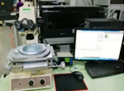
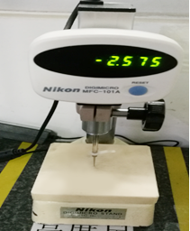
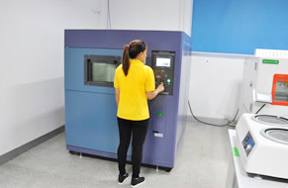
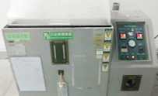
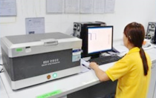
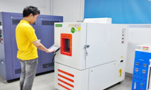
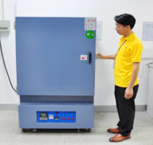
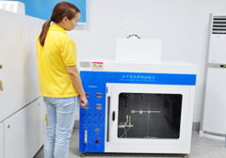
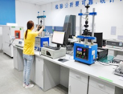
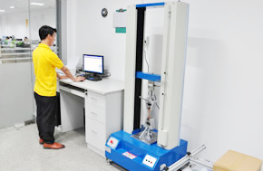
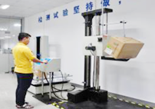
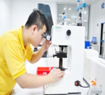
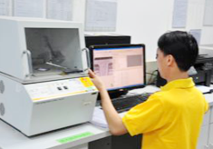
Quality Assurance
Electricity
Major test and measuring instruments
Dimension
Enviroment
Mechanic

Slide 9
Quality Assurance
Test and measuring equipments list
Purpose | Description | Model | Brand | Qty | Purpose | Description | Model | Brand | Qty
Mechanics | Metal Strength Testing Device | XM-SFC0002 | Xiangmin | 1 | Dimension | Image Dimension Measuring System | IM7030 | Keyence | 1
 | Microhardness tester | HV-1000 | Lianer | 2 |  | Tooling Microscope | MM-40 | Nikon | 1
 | Plating and Coating Thickness Tester | XULM XYM | Fischer | 1 |  | 2D Projector | V-12B | Nikon | 1
 | Automatic insertion-extraction force tester | MY-1220 | Hui Tai | 2 |  | Height gauge | MFC-101 | Nikon | 1
 | Insertion-extraction tester | YN70-15 | VTV | 6 |  | Height gauge | 10-C150MXB | Mitutoyo | 1
 | Drop tester | XD-DY1500 | Xiangmin | 1 |  | Optical measuring device | VMS-2010G | Wanhao | 7
Environment | Salt fog Tester | CZ-60A | Zonzhi | 1 |  | 2D Projector | CPJ-3015Z | Wanhao | 2
 | Thermal Shock Chamber | S3-08L-A-3 | Sanwood | 1 | Electricity | Contact impedance tester | HG2511 | Hui Gao | 1
 | Temperature and Humidity Tester | SH5500 | Sanwood | 1 |  | Temperature rise Tester | SI-10X | Sunjat | 1
 | X-Ray Spectrometer | EDX 2800 | Tianrui | 1 |  | Cable harness tester | CT-8681 | Yihe | 1
 | Horizontal-Vertical flammability tester | XM-HV001 | Xiangmin | 1 |  | Conductivity Tester | SMP350 | Fischer | 1

Slide 10
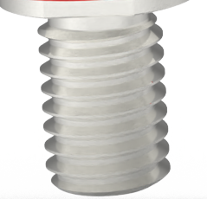
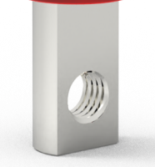
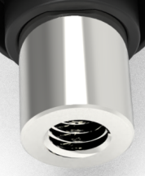
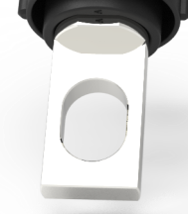
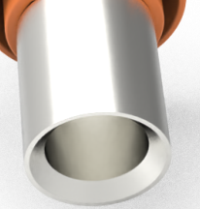
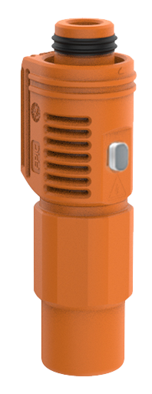
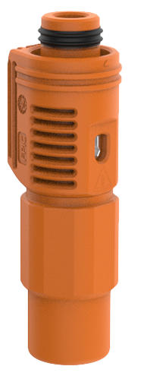
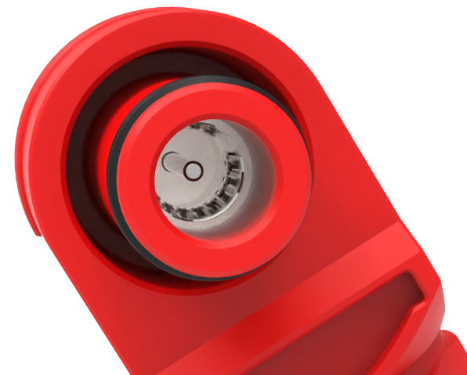
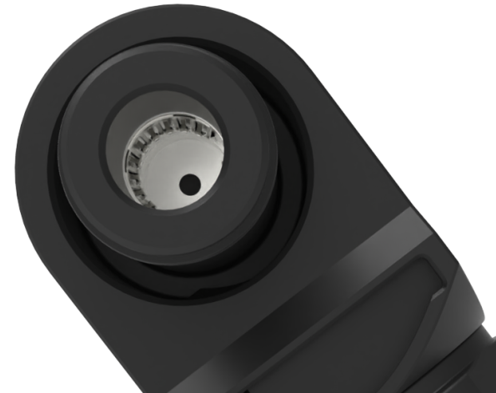
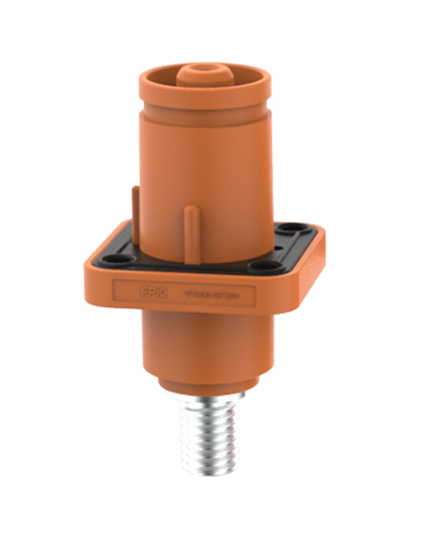
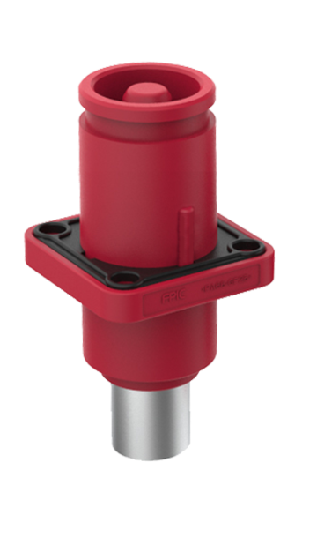
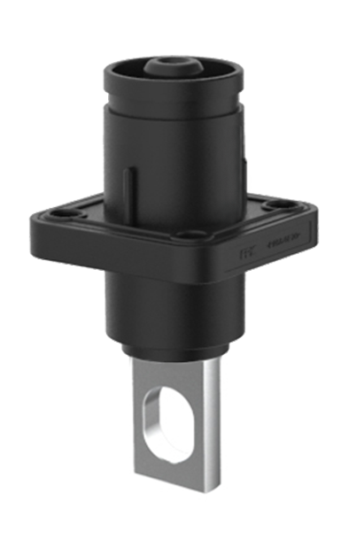
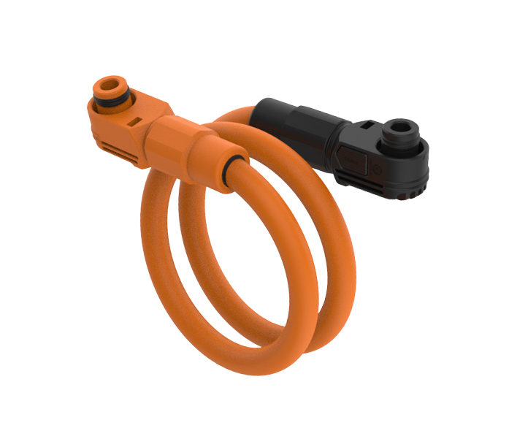
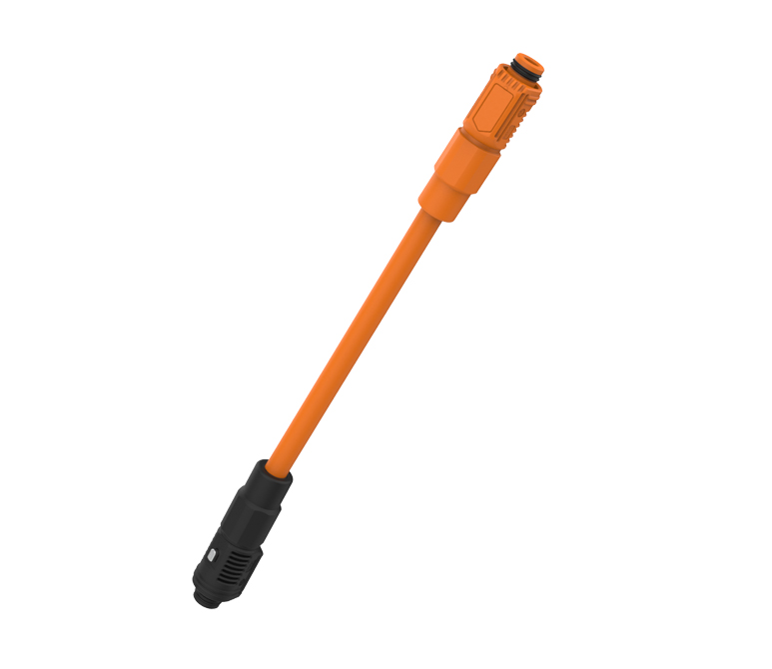
Our Products
Key Features:
Touch proof, safety, reliability
360° rotating plug, conserve space, operational
efficiencies
UL 4128 standard
IP67 waterproof
Different installation key on receptacles
Energy storage connectors & cables
Outer Thread
Copper Bar Inner Thread
Inner Thread
Copper Bar Thourgh Hole
Crimping
360°
360° Rotating
Press to release
Different installation key on pole and color
Tool unlock
Manually unlock
Different keying pisitions
Five connection method on each Pole and color
Touch proof
Installation key

Slide 11
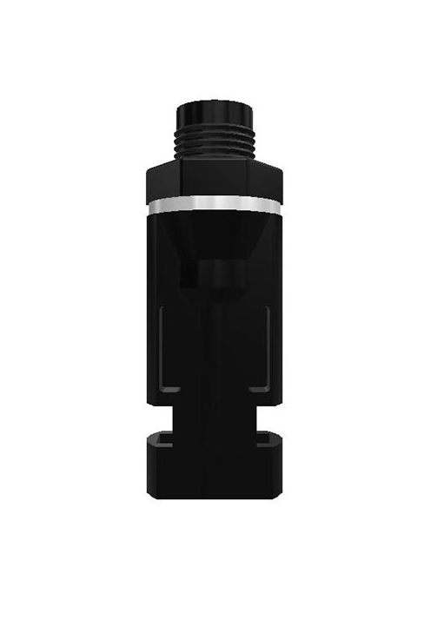
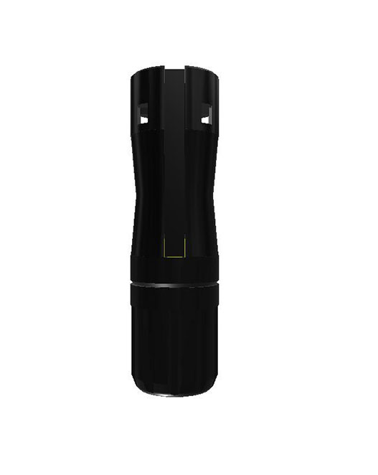
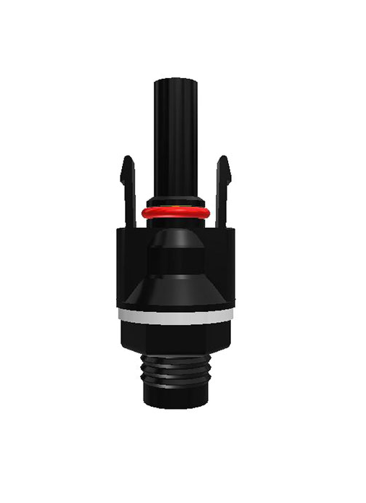









Our Products
Features:
Easy and quick installation, safe and reliable
Ergonomic and aesthetically pleasing
Customizable cable length
Solar Connectors & Cables
Solar Connectors & Cables

Slide 12




Our Products
Busbar
Features:
Strong overload capacity
Compact, simple, and aesthetically pleasing design
Available processes: molecular diffusion welding, film lamination, spraying, dipping
Rigid Busbars
Rigid Busbars
Laminated Busbars
Flexible Busbars

Slide 13






Our Products
Electric Vehicle HV Connectors & Cables

Slide 14







Our Products
Automotive connectors
Features:
Compact structure, stable and reliable threaded connection
Safe and reliable, compliant with IEC standards
Customizable cable length

Slide 15









Our Products
Circular connectors & cables
Features:
Mechanical life: 500 cycles
strong vibration resistance
IP67 waterproof
360-degree shielding
Temperature resistance: -40 to 105°C

Slide 16








Our Products
Industrial Wire Harness

Slide 17







Our Products
Medical Wire Harness

Slide 18


Our Products
PCBA connectors

Slide 19











Our Products
Metal parts
Composite Terminals
Spring-Clip Terminals--Automotive Standard
Press Fit Terminals
Spring-Clip Terminals
Shielding Covers
Terminal
Automotive Terminal
Automotive Clip
Stamped Fins
Folded Fins

Slide 20





Our Products
Insert Molding Parts

Slide 21

......
SRM
ERP
APS
Our Platforms
WMS
Intelligent manufacturing operration management platform
PLM
MES
QMS
SCADA
OA
BI
CRM

Slide 22






Certificates
Meet the Safety Standard of Management System
IATF16949
ISO9001
ISO13485
ISO14001
TUV Verified
UL Verified

Slide 23













Our Customers
1
Alaska
3
Europe
4
Russia
2
Canada
United States
7
Africa
5
8
Asia
9
Australia
6
South America

Slide 24
Our Strengths
Focusing on the connector and wire harness industry for over 20 years, we are able tvo provide you with more professional service in this industry.
We offer end-to-end solutions, including product design, mold design and manufacturing, parts production, automated assembly, testing, and packaging for connectors, wire harnesses, and metal parts.
The positioning of a small and beautiful enterprise can provide you high quality(vendor of several top brands in the industry), reasonably priced products, and quick response during the service process.
Zero risk of development promise: we’ll refund all development costs to customer, if our company’s development work can’t meet their requirement.

Slide 25

Welcome to visit us!
Shenzhen Forman Precision Industry Co., Ltd.
Building K, No. 2, Longshan Eighth Road, Luotian Community,Yanluo Street, Baoan District, Shenzhen City, GD, China.

